Slide 1
UW Fintech Bootcamp project 2
Will Dittig
Jansen Eichenlaub
Meghan Kennedy
Daniel McCaffrey
December 2021

Slide 2
Crypto Purchase Bot
We created a bot that would buy and sell different crypto currencies
We used sklearn svm to train our bot
We chose Alpaca because it would allow paper trades
We chose BTC, ETH, LTC, and BCH because Alpaca supported them

Slide 3
Data collection and Preparation
We spent a lot of time adjusting the model to try and get better accuracy but had trouble getting anything over 50%
Since the model wasn’t giving us the indicators we wanted, we tested the buy/sell part of the code to make sure it worked
We pulled data back to 12/31/17 for each coin and cleaned them separately
We prepped the coins separately so that we could adjust the models as needed
We started with a stagnate csv to train the models but then realized we needed live data for the bot to do the buy/sell at the end
We used yfinance to pull the data instead of alpaca
Training the Model

Slide 4
Challenges
Next Steps
Google Colab did not work as we expected it to
It was very difficult for us all to work on the file at once
The save feature caused us to lose have of our code on several instances
Using minute by minute data for a more up to date application
Running the application in the command prompt
Using different machine learning model variations instead of Moving averages

Slide 5
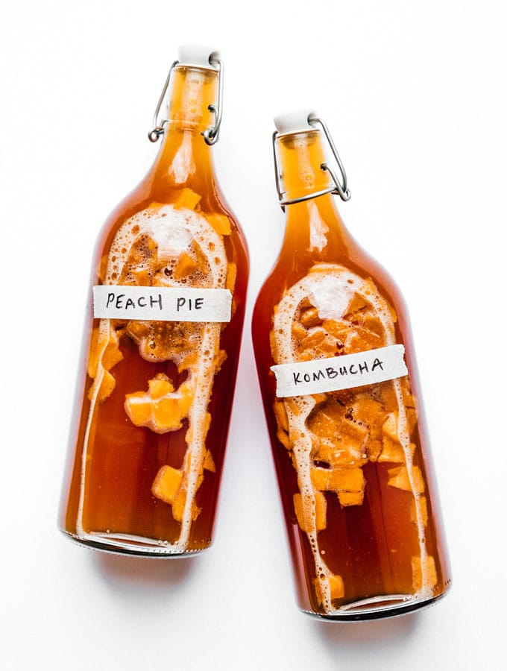
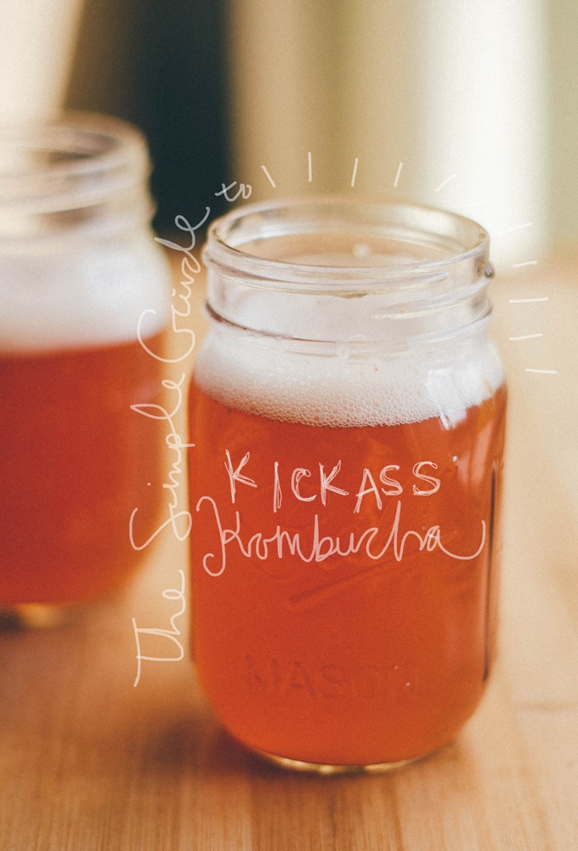
TEAM DUMBLEBUCHA

